Slide 1

CCS6314
CRYPTOGRAPHY
AND DATA SECURITY
(Dr. CHAN WAI KOK)
Note: Slides taken from Dr Tea (from previous Semester) & modified accordingly

Slide 2

What is Cryptography ?
Cryptography:
Art and science of providing secrecy and security to communication.
The process of hiding or coding information so that only the person a message was intended for can read it. (Source: Fortinet)
# We will learn much more about various cryptographic techniques, ranging from classical to modern types, including symmetric and asymmetric in the syllabus later.

Slide 3

What is Data Security ?
Data Security:
The process of safeguarding digital information throughout its entire life cycle to protect it from corruption, theft, or unauthorized access.
It uses tools and technologies that enhance visibility of a users’ data.
These tools can protect data through processes like data masking, encryption, and redaction of sensitive information. (Source: Fortinet)

Slide 4

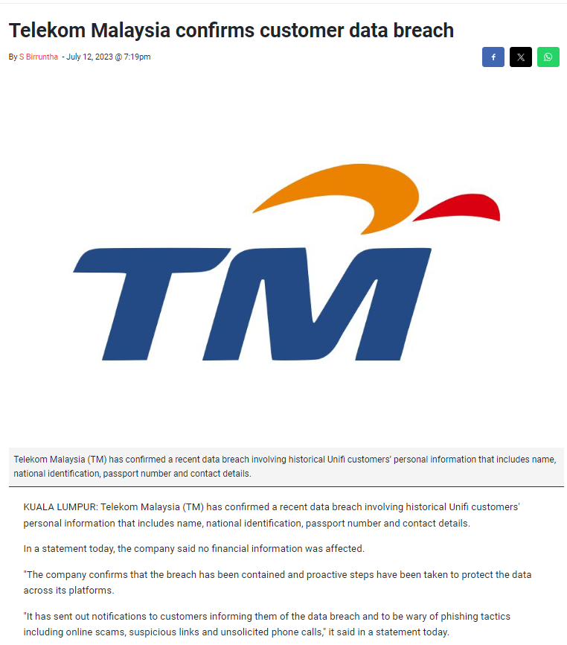
So why are they important ?
Organizations are legally obliged to protect customer and user data from being lost or stolen and ending up in the wrong hands.
It is crucial to preventing the reputational risk that accompanies a data breach. A high-profile hack or loss of data can result in customers losing trust in an organization and taking their business to a competitor.
This also runs the risk of serious financial losses, along with fines, legal payments, and damage repair in case sensitive data is lost. (Source: Fortinet)
Cryptography provides solution to resolve all the above-mentioned issues.

Slide 5
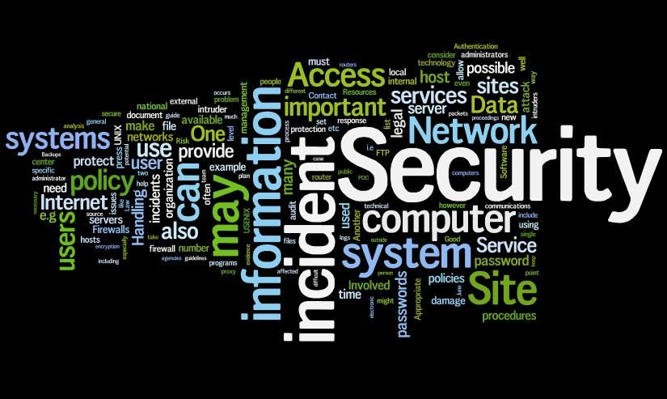
Syllabus Contents:
What will you learn in this course?
Introduction to data and information security.
Mathematical foundations.
Classical and modern symmetric ciphers.
Modern asymmetric ciphers.
Various cryptographic algorithms for specific objective.
Key management and distribution.
Recent trends in / futures of cryptography.

Slide 6
Course Content:
Solely 100% coursework-based – No final examination.
Throughout the trimester:
Quizzes: 2 (Physical-based with 10% each) – Total: 20%
Tests: 2 (Physical-based with 20% each) – Total: 40%
Assignment：1 or 2 (TBD later) (Group-based with report and oral presentations)
– Total: 40%

Slide 7
Course Structures:
Lecture Session (2 hours per week):
Tutorial Sessions (2 hours per week):
Lecture Group | Day | Time | Venue
TC1L | Thursday | 6 pm to 8pm | CNMX 1004
TC2L | Friday | 10am-12 am | AR1009-FCI
Tutorial Group | Day | Time | Venue
TT1L | Wednesday | 12 – 2 pm | AR2005 Cisco
TT2L | Tuesday | 8am – 10 am | AR2005 Cisco
TT3L | Friday | 5pm-7 pm | AR2003
TT4L | Wednesday | 4pm to 6 pm | AR2003
TT5L | Tuesday | 4pm to 6pm | AR2003
TT6L | Monday | 4pm to 6pm | AR2003

Slide 8
Main Reference Books
Stallings, W. (2020). Cryptography and Network Security: Principles and Practice (8th ed.). Pearson.
Forouzan, B. A. & Mukhopadhyay, D. (2015). Cryptography & Network Security (3rd ed.). McGraw-Hill.
Stinson, D. R. & Paterson, M. (2019). Cryptography: Theory and Practice (4th ed.). Taylor & Francis.
Kahate, A. (2019). Cryptography and Network Security (4th ed.). McGraw-Hill.

